Slide 1

"Hire Me or Not? Image Classifier Fun"
by Susy Costa
2023

Slide 2
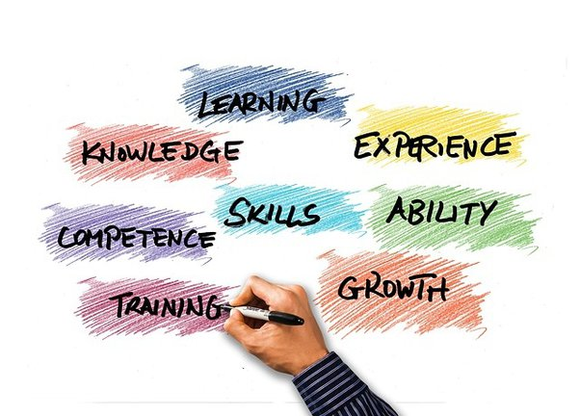
WHAT’S THE GOAL
Create a fun web tool that, through a model, playfully evaluates:
job skills through image classification
Creates fun, skill-based suggestions
encourages users to share their unique strengths on social media

Slide 3

SKILLS KEY ASPECTS
excel in endeavors
fostering adaptability
problem-solving
personal growth.

Slide 4
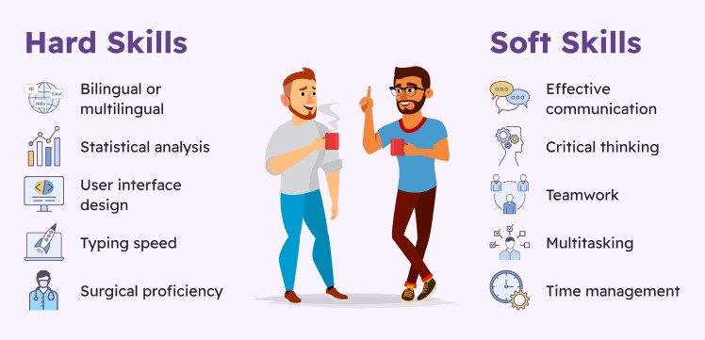
MAIN SKILL CATEGORIES
Hard skills are quantifiable and teachable capabilities, often gained through education or experience and they are specific and job-related.
Hard skills are quantifiable and teachable capabilities, often gained through education or experience and they are specific and job-related.

Slide 5
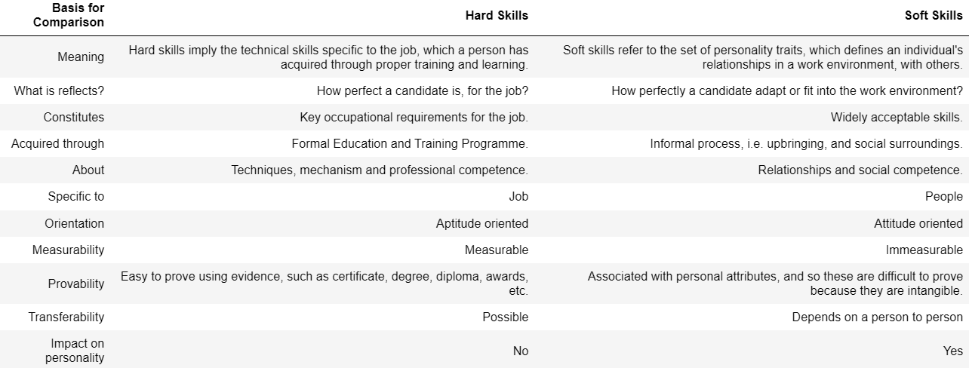
BASIS FOR COMPARISON

Slide 6
EUROPEAN SKILL RANK
Skills Development
Skills Activation
Skills Matching
how effectively people in a country are enhancing their skills
how effectively people use their skills in real life
examines if people's skills match what the job market needs

Slide 7

LET’S
PLAY
THE GAME!

Slide 8

THANK YOU!

